Slide 1
Python by smell
Advanced Python constructs for scientists
Pietro Berkes, Nagra Insight

Slide 2
What’s this smell?
Scientists in the wild tend to write this…
You’re here because you started feeling the “code smell” (a technical term)
You can already feel the smell: what is wrong with the code in the notebooks?
Notes:
~/n/MH/nagra_git/thesis/generative Open Generative%20model%20-%20Mixture%20of%20gaussians_EM_markovModels_soft_clustering-plotLH-C%2BCLEAN-LH_TEST-4k-Copy1.ipynb
Then open any other with similar name
It smells like you need a Python module

Slide 3
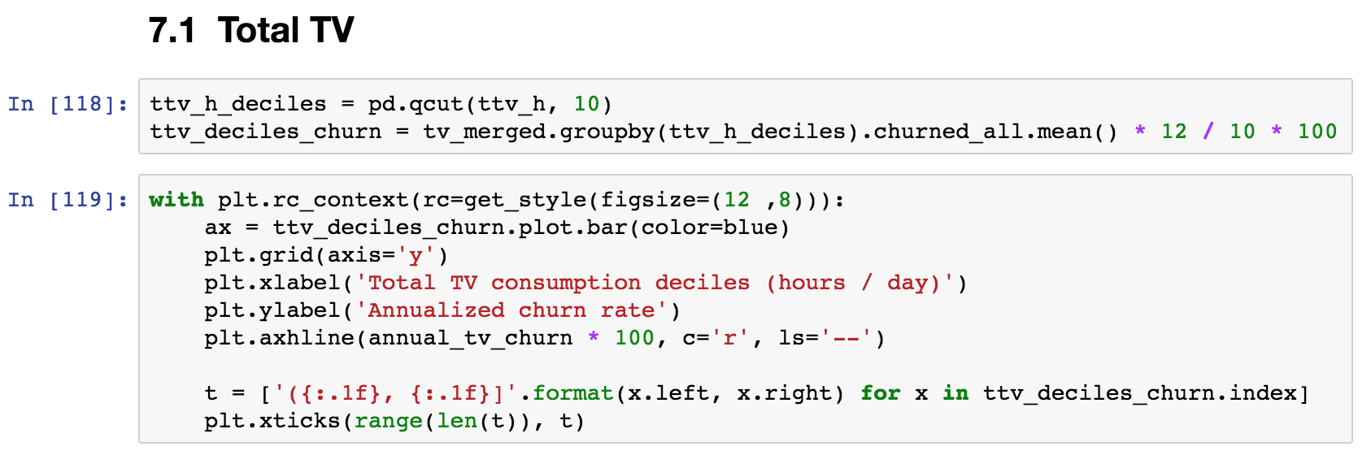
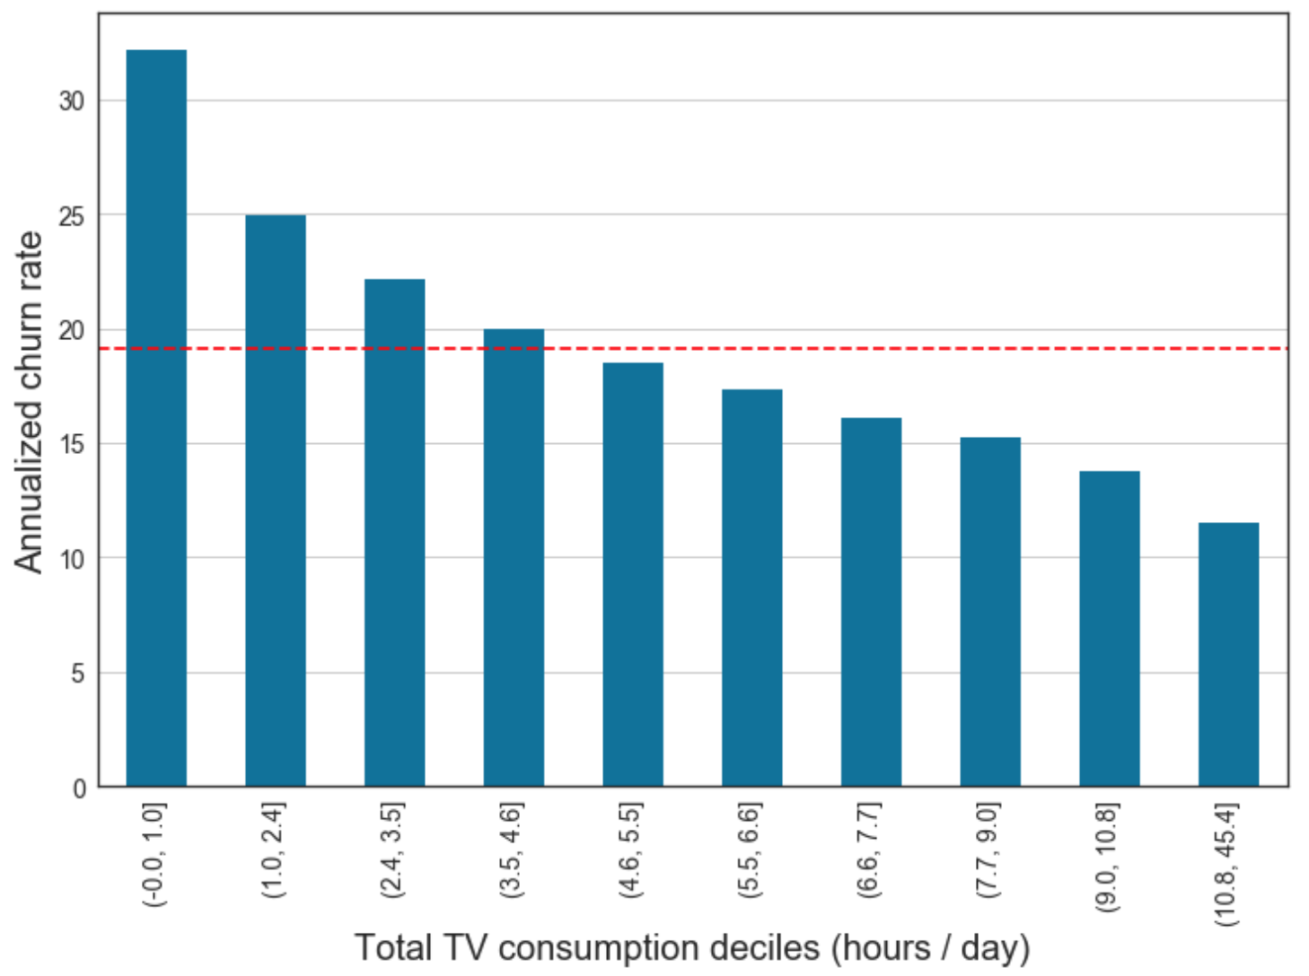
What about this smell?

Slide 4
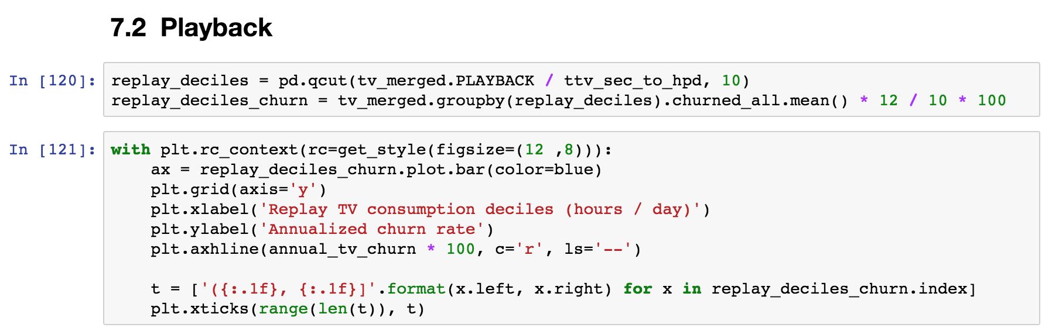
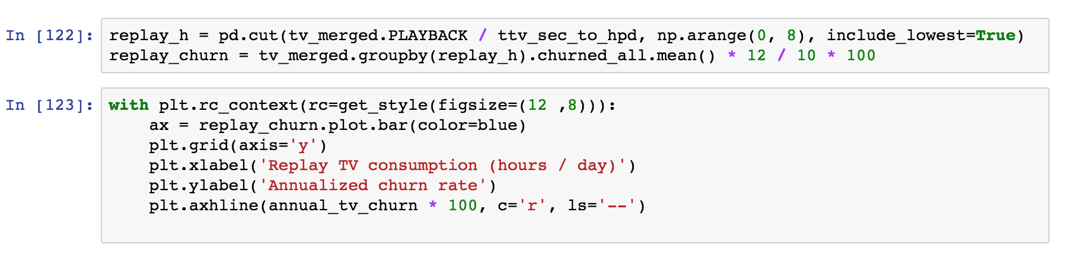
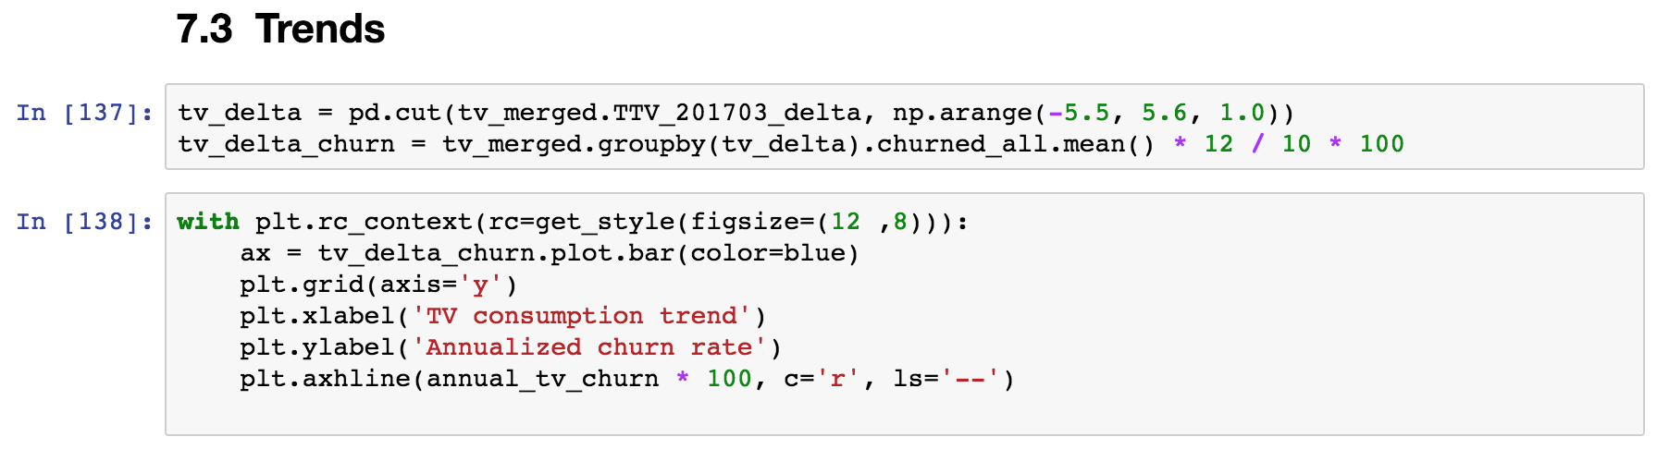
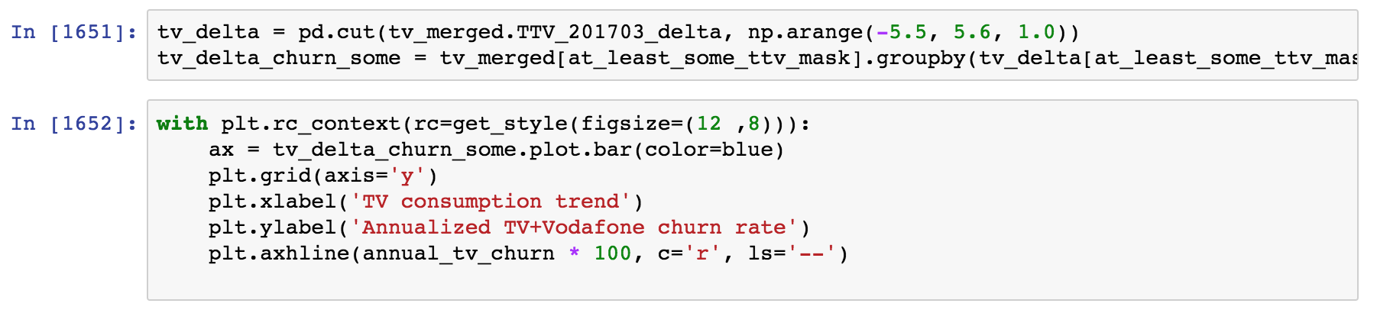
What about this smell?

Slide 5
What is wrong with smelly code?
Redundant, not flexible: an update in one place would need to be duplicated everywhere
Hard to test: the code that performs the interesting computation is mixed with the code that does the repetitive boilerplate

Slide 6
Objective
This is a code smell detection crash course for scientific programming
Advanced Python constructs are there to get rid of the smell!
Notes:
These constructs are not very common in scientific code, and you don’t actually ”need” them. But the same is true of functions!

Slide 7
All the smells
The smell of generators
The smell of decorators
for ... :
# Transform / filter
for ... :
# Transform / filter
# The interesting part of the code
def my_function(x, y, z):
# Common boilerplate
# Function-specific part
# Common boilerplate
The smell of context managers
The smell of classes
# Prepare
try:
# The code you care about
finally:
# Clean up
def first_function(x, y, z):
# Something
def second_function(x, y, z):
# Something else
def third_function(x, y, z):
# Something more

Slide 8
The smell of generators
One or more nested loops, variables over which one iterates requires some extra transformation or filtering
for ... :
# Transform / filter
for ... :
# Transform / filter
# The interesting part of the code
This is the part that actually does some interesting computation. At the moment, it’s hard to test it!
… becomes …
for ... in my_generator():
# The interesting part of the code

Slide 9
The smell of classes
def first_function(x, y, z):
# Something
def second_function(x, y, z):
# Something else
def third_function(x, y, z):
# Something more
The same set of parameters is needed for a set of functions. In code calling this function, one needs extra code to keep these parameters in sync.
… becomes …
def first_function(xyz):
# Something
def second_function(xyz):
# Something else
def third_function(xyz):
# Something more
class Xyz:
def __init__(self, x, y, z):
...

Slide 10
The smell of context managers
Before executing the code, something needs to happen: open a file, connect to a DB, initialize some hardware
# Initialize context
try:
# The code you care about
finally:
# Clean up context
Once the code has executed, we need to clean up, even if an error occurred: close the file, commit / revert SQL transactions, disconnect from hardware
… becomes …
with my_context_manager():
# The code you care about

Slide 11
The smell of decorators
Boilerplate code at the start and/or end of functions.
Typical cases: logging, deprecation, conditions checks, caching
def my_function(x, y, z):
# Boilerplate at start
# Function-specific part
# Boilerplate at end
This is the part that is specific to what the function actually does
… becomes …
@my_decorator
def my_function(x, y, z):
# Function-specific part

Slide 12
One smell at the time… generators first

Slide 13
The smell of generators
One or more nested loops, variables over which one iterates requires some extra transformation or filtering
for ... :
# Transform / filter
for ... :
# Transform / filter
# The interesting part of the code
This is the part that actually does some interesting computation. At the moment, it’s hard to test it!
… becomes …
for ... in my_generator():
# The interesting part of the code

Slide 14
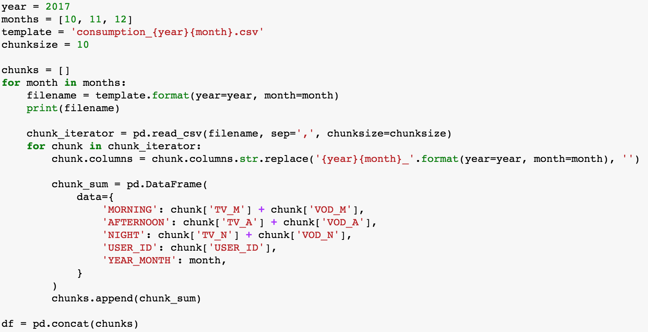
Example
Explain context…
Needed to do this for different years, with different computations
Testing this thing will require creating fake, messy files <- this is a complicated point to make, with a generator it requires mocking it…

Slide 15
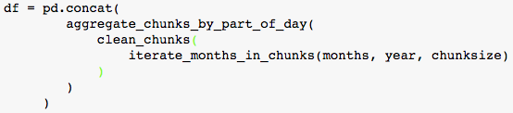
Ideally…
This is actually what we’d like to write.
All of this without actually loading all the data in memory for the intermediate steps!
Before getting here this we need to do a step back…

Slide 16
Go to “generators” notebooks

Slide 17
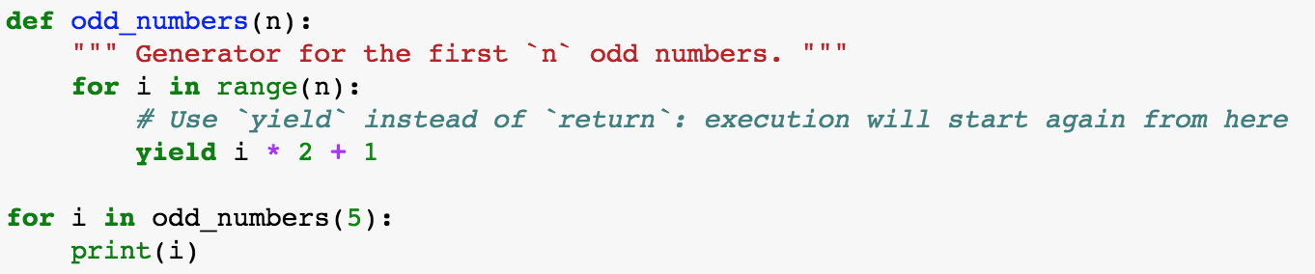
Recap: Generators
Generators are used to get rid of repetitive loops, often nested ”for” loops followed by filtering of the data
Generators return one item at the time, the list of items does not need to be in memory
A generator is defined as a function containing the keyword ”yield”:

Slide 18
One smell at the time… classes (an introduction)

Slide 19
The smell of classes
def first_function(x, y, z):
# Something
def second_function(x, y, z):
# Something else
def third_function(x, y, z):
# Something more
The same set of parameters is needed for a set of functions. In code calling this function, one needs extra code to keep these parameters in sync.
… becomes …
def first_function(xyz):
# Something
def second_function(xyz):
# Something else
def third_function(xyz):
# Something more
class Xyz:
def __init__(self, x, y, z):
...

Slide 20
Go to “classes” notebooks

Slide 21
Recap: Classes
Classes are used to get rid of set of parameters that belong together and are passed over and over to a set of functions
Classes are templates for bundles of data and “methods”, i.e. functions that have access to the data stored in an instance
A ”class method” is used to build an instance in some alternative way, e.g. using data from a file

Slide 22
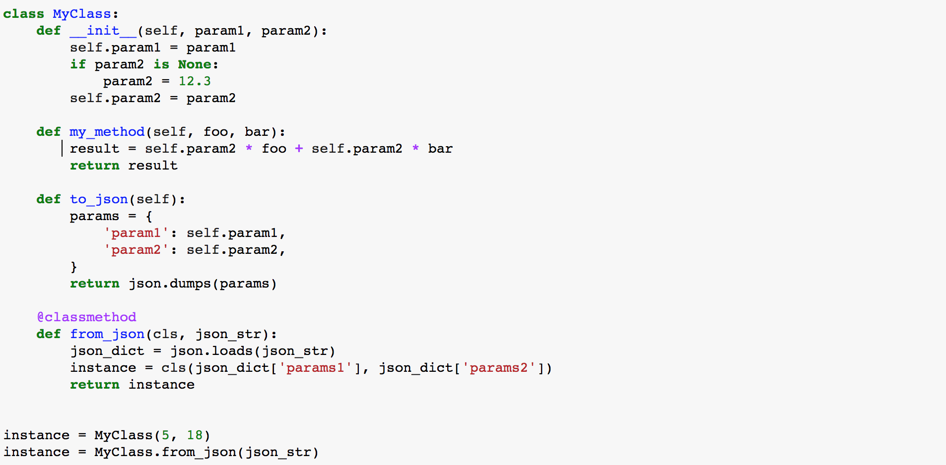
Recap: Class structure
The constructor is used to first populate an instance, called by convention “self”
Classes can define “methods”, i.e. functions that have access to the data stored in an instance
A ”class method” is used to build an instance in some alternative way, e.g. using data from a file
Here is how you create instances from the constructor or a class method

Slide 23
What belongs to a class?
YES
Data that always belongs together: better create several simple classes than one class that contains everything
Methods to load/save data, create data bundle in different ways (factory methods)
Methods to update parameters
NO
Methods to visualize data: Model-View pattern. You will want to visualize the data in many different ways, better have separate utility visualization functions that take one of the instances as input and visualize them.
Similarly, anything for which you can imagine to write 5 different variants depending on your mood
Notes:
Data that belongs together, example: parameters of an experiment and results of the experiment

Slide 24
Another smell of classes
for data in list_of_data:
if data['type'] == 'TYPE1':
type1_foo(data)
type1_bar(data)
elif data['type'] == 'TYPE2':
type2_foo(data)
type2_bar(data)
Several “specializations” of conceptually similar functions
… becomes …
Classes may have methods with the same interface, the class type determines the “specialization”.
One can even define a hierarchy of classes where some methods are re-used!
for instance in instances:
instance.foo(data)
instance.bar(data)

Slide 25
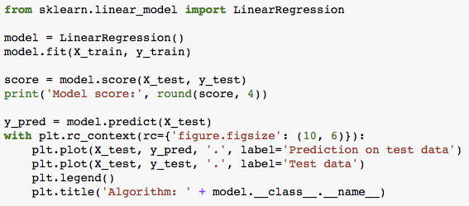
Example: sklearn
Model score: 0.0066

Slide 26
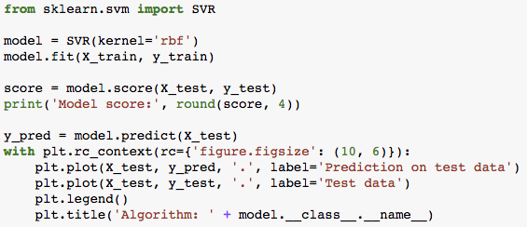
Example: sklearn
Model score: 0.6144

Slide 27
One smell at the time… Context managers

Slide 28
The smell of context managers
Before executing the code, something needs to happen: open a file, connect to a DB, initialize some hardware
# Initialize context
try:
# The code you care about
finally:
# Clean up context
Once the code has executed, we need to clean up, even if an error occurred: close the file, commit / revert SQL transactions, disconnect from hardware
… becomes …
with my_context_manager():
# The code you care about

Slide 29
Go to “context managers” notebooks

Slide 30
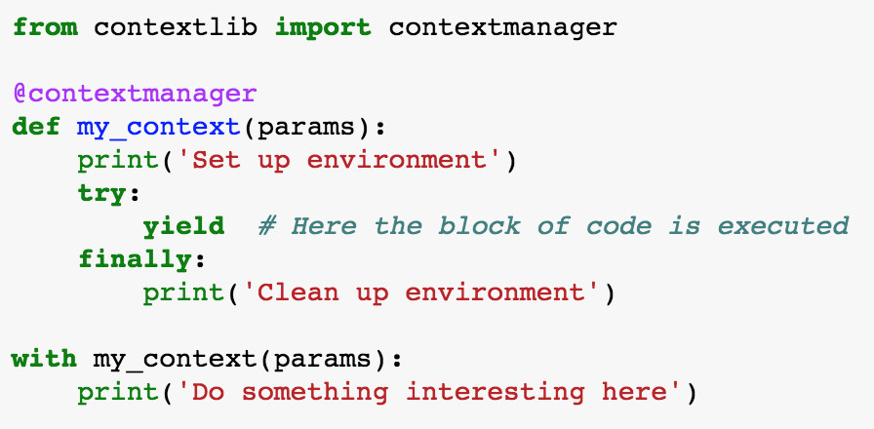
Recap: Context managers
Context managers eliminate the smell of repeatedly setting up and cleaning up an environment in which code needs to run

Slide 31
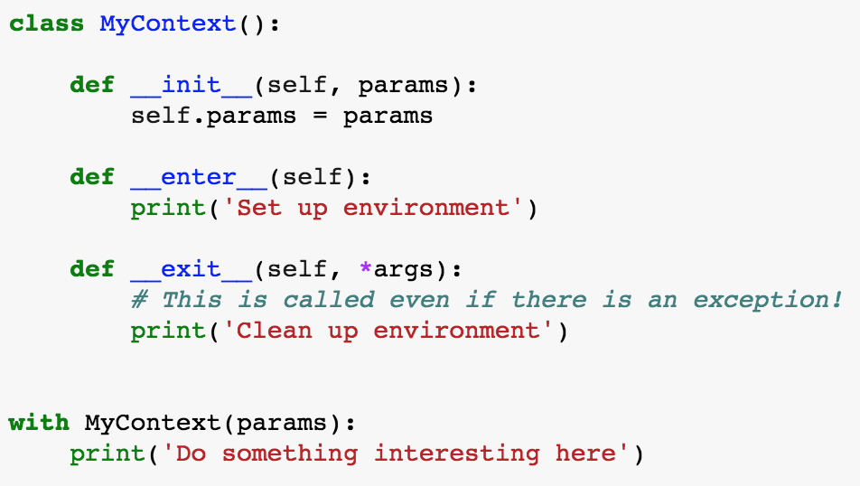
FYI: most general way of defining context manger
@contextmanager is really a shortcut for writing a class with magic methods __enter__ and __exit__:

Slide 32
Where to go from here…
realpython.com

Slide 33
Thank you!

